Slide 1

SOLAR POWER PREDICTION
ML + Edge Impulse (BYOM) + WebAssembly

Slide 2



PROBLEM STATEMENT
The primary goal is to predict the maximum solar power output to determine the most efficient placement for solar panels.
Analyze environmental & meteorological data.
•
Estimate solar irradiance for the next 24 hours.
Optimize energy generation efficiency.

Slide 3






DATASET & FEATURES
INPUT FEATURES
DATA SOURCE
TARGET VARIABLE
35 comprehensive input features including weather conditions and environmental parameters.
NASA POWER Project
Solar Irradiance
(Continuous numeric value)
power.larc.nasa.gov/data-access-viewer/

Slide 4
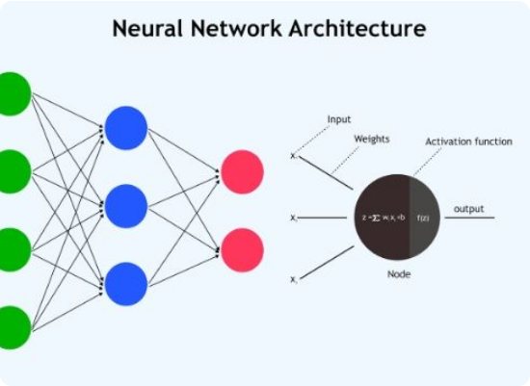
MODEL ARCHITECTURE (PYTHON)
REGRESSION NEURAL NETWORK
Input Layer: 35 Features
Hidden Layer 1: Dense(20), ReLU
Hidden Layer 2: Dense(10), ReLU
Output Layer: Dense(1) (Continuous)

Slide 5











TECHNOLOGY STACK
PYTHON / TF / KERAS
TFLITE
OPENMETEO API
Model training & creation.
Optimized model format.
api.open-meteo.com/v1/forecast
CHART.JS
GITHUB PAGES
WEBASSEMBLY
Interactive 24-hour prediction plotting.
Static hosting solution.
Client-side model execution.

Slide 6


EDGE IMPULSE (BYOM) WORKFLOW
UPLOAD
CONFIGURE
VALIDATE
DEPLOY
Upload .tflite model via BYOM.
Set output to Regression.
Automatic tensor shape validation.
Export as WebAssembly (WASM).

Slide 7

WEBASSEMBLY INTEGRATION
The WASM package enables the model to run entirely in the browser, ensuring low latency and data privacy.
Downloaded WASM ZIP from Edge Impulse.
Integrated into HTML/JS webpage.
Feeds live API data to model in-browser.
Chart.js visualizes the 24h forecast.

Slide 8


HOSTING & ARCHITECTURE
GITHUB PAGES
CLIENT-SIDE EXECUTION
Free, reliable static hosting. Eliminates the need for complex backend infrastructure or cloud compute costs.
The entire pipeline—from data fetching to inference and visualization—runs locally on the user's device.

Slide 9

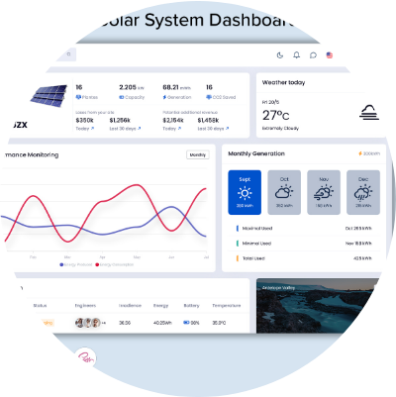

LIVE DEMO
TRY THE WEB APP
Experience the 24-hour solar power prediction live in your browser.
yashsolanki1166.github.io/Solar_power_predictor/
Live Weather API Integration
Real-time Inference
Interactive Charts

Slide 10
PROJECT SUMMARY
"A machine learning–based solar prediction system that identifies the optimal placement of solar panels by forecasting maximum solar power output. Built in Python, converted to TFLite, imported via Edge Impulse, and deployed on GitHub Pages using WebAssembly."

Slide 11






IMAGE SOURCES
https://static.vecteezy.com/system/resources/previews/045/593/230/large_2x/solar-panels-in-a-sunny-field-of-flowers-photo.jpg
Source: www.vecteezy.com
https://ik.imagekit.io/upgrad1/abroad-images/imageCompo/images/neural_network_architecture8XR2PC.jpg?pr-true
Source: upgrad.com
https://www.edgeimpulse.com/blog/content/images/assets/ei_cycle_d_e59c64ebeda3ccc80fa9a298cd0835f2_944901ad41-2.jpg
Source: www.edgeimpulse.com
https://moldstud.com/_next/image?url=https%3A%2F%2Fmoldstud.com%2Fuploads%2Fimages%2Fexploring-webassembly-the-future-of-web-development-with-javascript-bu.webp%3Fw%3D1216%26h%3D912&w=3840&q=75
Source: moldstud.com
https://multipurposethemes.com/wp-content/uploads/2024/10/solar-dashboard-mpt-blog-7.jpg
Source: multipurposethemes.com

